Slide 1
Environmental Influences on pathogen spillover in a multihost forest disease
Whalen Dillon | IALE World Congress | July 6, 2015

Slide 2

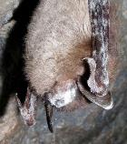
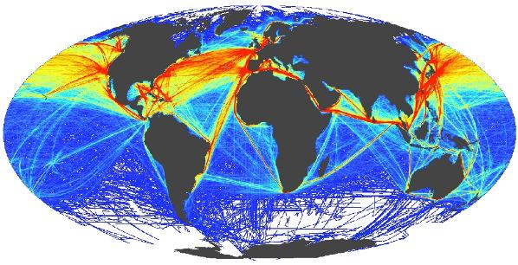

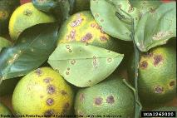
Emerging Infectious Diseases (EIDs)
New in a population, or known but rapidly increasing
Halpern et al. 2008. A Global Map of Human Impact on Marine Ecosystems. Science
Human
HIV
Lyme
Ebola
Non-human animal
Mad cow ()
White nose syndrome
Chytridiomycosis (‘phibs)
Plant
Potato blight (Phytophthora infestans)
Citrus canker
Chestnut blight
Notes:
New in a population, or known but rapidly increasing in incidence or geographic range. Often noticed because they threaten the well-being of our socio-ecological systems, either directly to human health, or indirectly through impacts to food security or valued biodiversity. Ensuring the health of our systems requires effective prevention and response to emerging diseases, which in turn requires understanding the interaction between between the disease and its environment.
Links to pictures: http://blog.sunlighten.com/wp-content/uploads/2011/10/lyme1.jpg | https://encrypted-tbn0.gstatic.com/images?q=tbn:ANd9GcTHXXJBcB-OvfF-Sa8J2Wo5tlPRpLntqwX0lj55vYp61xnq81nH | http://www.thehealthsite.com/news/ebola-virus-is-mutating-rapidly-say-scientists/ | http://idtools.org/id/citrus/diseases/factsheet.php?name=Citrus%20canker | http://dendro.cnre.vt.edu/forsite/paul/paul1.htm

Slide 3
Disease Triangle
Disease
Pathogen
Susceptible Host(s)
Favorable Environment
DISEASE
Host(s)
Environment
Pathogen
Notes:
Any disease can be described by the three sides of the disease triangle, which may be better understood using a Venn diagram, because without the favorable interaction of all three factors there will not be disease. (could use the amount of overlap to indicate specific disease characteristics, e.g. narrow or broad environmental conditions or number of host species)

Slide 4
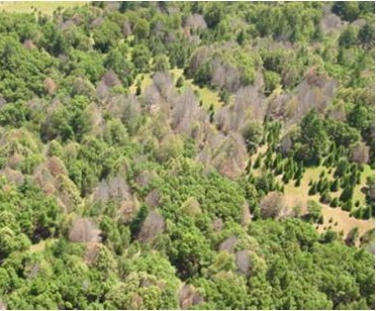
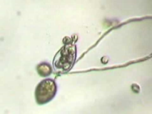
Sudden Oak Death (SOD)
Phytophthora ramorum (oomycete) - water mold
P. ramorum
SOD
Trees
&
Shrubs
California
Forests
Notes:
To examine the relationships between pathogen spillover, coexistence, and environmental heterogeneity I focus on the forest disease sudden oak death. It is caused by P. ramorum, which is moisture dependent, and sensitive to temperature and light.

Slide 5
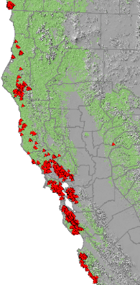
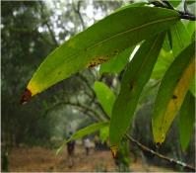
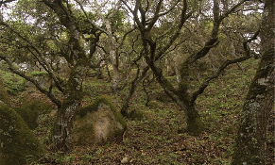
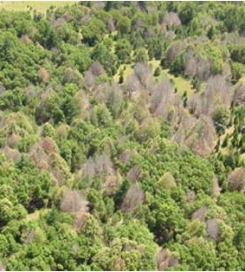

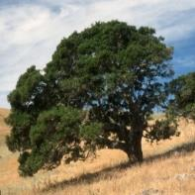
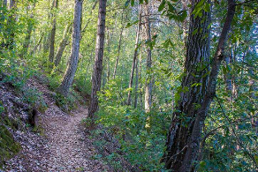

Sudden Oak Death
46 wildland host species (generalist) – 5 key host tree species
Notes:
Coast live oak, California black oak, canyon live oak, tanoak, and California bay laurel. Of particular importance are Coast live oak, California black oak, tanoak, and California bay laurel. As the name suggests, the oak trees are killed by this disease, but that is only the beginning of the story because they do not effectively transmit the pathogen. They are “dead-end” hosts. Transmission is predominantly driven by the foliar host California bay laurel, which does not suffer negative effects from infections.

Slide 6

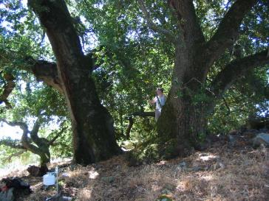
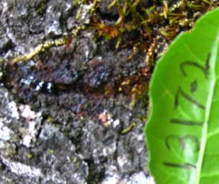
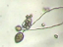
Pathogen Spillover (SOD)
“when disease epidemics are driven by transmission from an alternate reservoir host population” – Power & Mitchell (2004)
Notes:
The asymmetry in host competency for pathogen transmission can be described by pathogen spillover. Spillover is a predicted characteristic of multihost pathosystems (interspecific). Interspecific vs. Intraspecific: intraspecific if there are individuals responsible for greater proportion of transmission events.
Reference: “Pathogen Spillover in Disease Epidemics” Am. Nat.

Slide 7

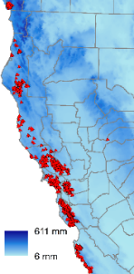
Research Question
How does environmental variation in space & time influence pathogen spillover?
611mm
6mm
Notes:
Now, understanding more precisely the scale at which environmental heterogeneity is likely to be related to pathogen spillover I aim to examine how specific aspects of the environment influence this mechanism. In other words, how do environmental conditions, such as the temperature, rainfall, and local plant community, influence pathogen reproduction and subsequent infection and mortality of oak species across the landscape?

Slide 8
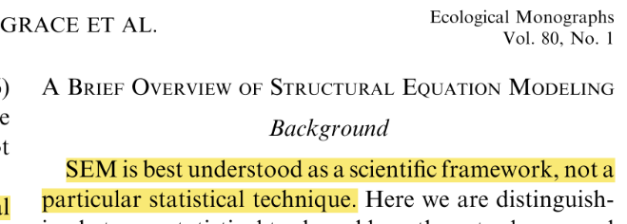
Analytical Framework - SEM
Structural Equation Modeling (of repeated measures)
Notes:
SEM is better thought of as a scientific framework rather than a specific statistical technique. Explicitly relates observation to theory. It may be used to conceptualize and test a comprehensive set of hypothesis about a system in either a confirmatory or exploratory effort. “for when causal questions can’t be answered with randomized experiments” – Shipley 2004

Slide 9
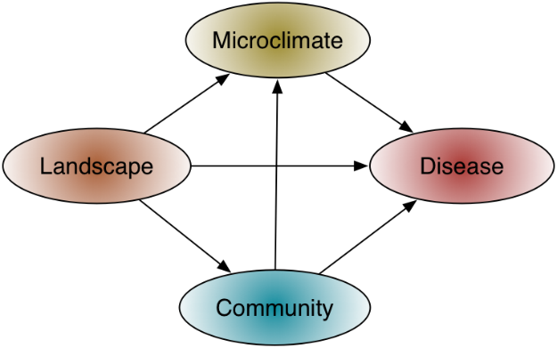
SEM Framework
Notes:
Structural equation meta-model conceptualizing the relationships among theoretical constructs that influence infection and spillover in the SOD system. Using this approach I can discern the direct, indirect, and total effect of observations across hierarchical levels. For example, a characteristic of the landscape may have a direct effect on disease, and also an indirect effect through microclimate and community. The total effect is composed of the direct and indirect effects.

Slide 10
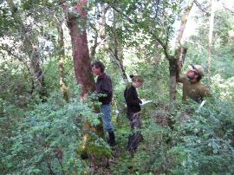
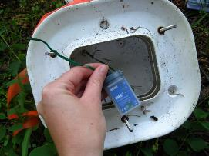
Data - Spillover
Permanent monitoring plots
Ecology
Microclimate
Notes:
200 plots visited annually 2004-2012, and most recently in 2014; 14 rain gauge stations

Slide 11
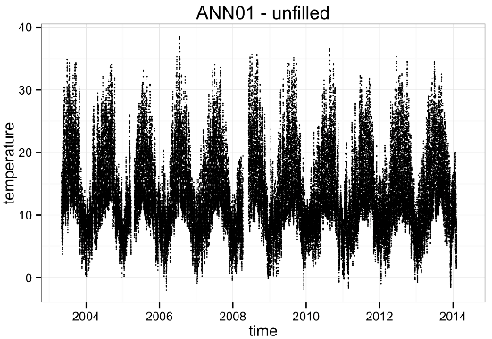
Data Processing
Unfilled Microclimate
Notes:
Hourly resolution across all plots.

Slide 12
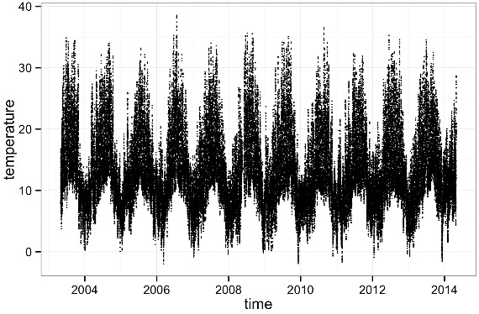
Data Processing
Filled Microclimate
https://github.com/f-tonini/Microclimate-Sonoma
Notes:
Maximum resolution of one hour across all plots.

Slide 13
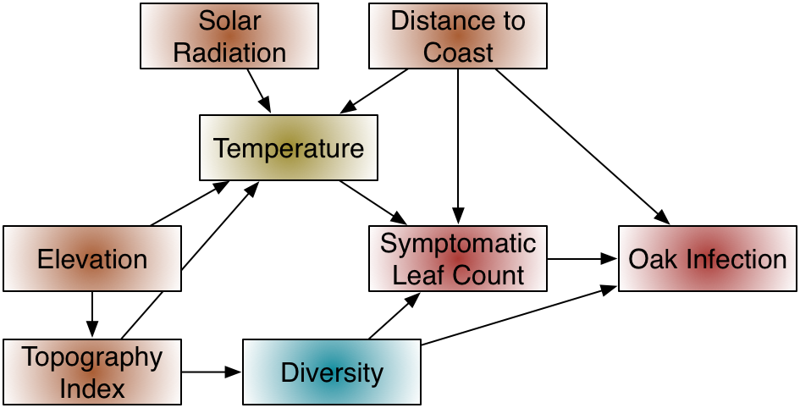
Path Model – Spillover
Spillover
Notes:
Diagram of a “snapshot” (single set of measurements) path model. An immediate challenge that may be seen in this framework is the different distributions these data will have, e.g. infection is binomial, while leaf counts may resemble a Poisson distribution. The different distributions of various response variables in a path model can be effectively handled using the d-sep (directional separation) test.

Slide 14
Path Model – Spillover
2005 Model
0.02
-0.03
-0.37(ns)
-0.31
-0.05
-0.39
Spillover
-0.05
0.71
-0.05
-0.02(ns)
-0.33(ns)
-0.04(ns)
Notes:
Diagram of a “snapshot” (single set of measurements) path model. An immediate challenge that may be seen in this framework is the different distributions these data will have, e.g. infection is binomial, while leaf counts may resemble a Poisson distribution. The different distributions of various response variables in a path model can be effectively handled using the d-sep (directional separation) test.

Slide 15
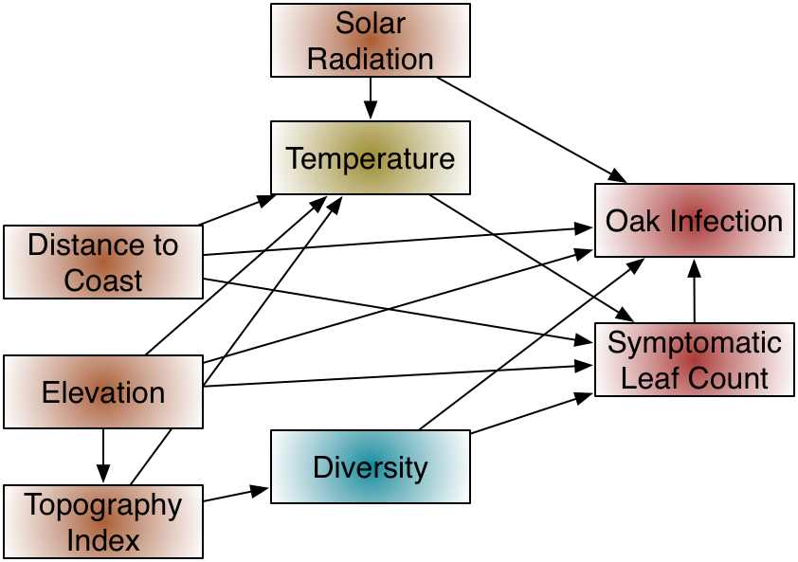
Path Model – Spillover
2014 Model
Notes:
Diagram of a “snapshot” (single set of measurements) path model. An immediate challenge that may be seen in this framework is the different distributions these data will have, e.g. infection is binomial, while leaf counts may resemble a Poisson distribution. The different distributions of various response variables in a path model can be effectively handled using the d-sep (directional separation) test.

Slide 16
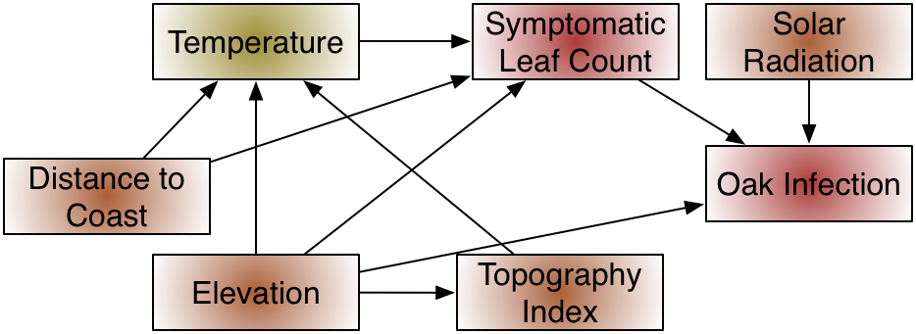
Path Model – Spillover
2014 Model
-0.18
-0.16
0.36
0.47
-0.05
0.10
0.2
-0.07
-0.39
-0.05
Notes:
Diagram of a “snapshot” (single set of measurements) path model. An immediate challenge that may be seen in this framework is the different distributions these data will have, e.g. infection is binomial, while leaf counts may resemble a Poisson distribution. The different distributions of various response variables in a path model can be effectively handled using the d-sep (directional separation) test.

Slide 17
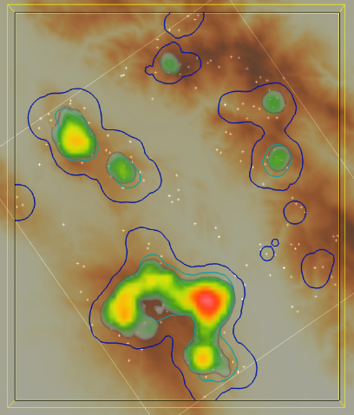
Pathogen Hotspots
N
N
N
Notes:
Because of the characteristics of the system we would expect there to be variation in disease intensity across the landscape and through time, resulting in hot spots where disease is high, and other locations were disease is low or absent. Visualization of disease intensity (symptomatic leaf counts) on bay laurel in space and time. This lends support to further examination of how the environment is influence pathogen spillover from bay laurel to oak. Since P. ramorum is sensitive to environmental factors and California bay laurel is the host that would be driving spillover we would expect that infection intensity would vary across the landscape, resulting in hot spots of infection.

Slide 18



Pathogen Spillover & Coexistence
Spillover to dead end hosts (mortality) may increase reservoir host abundance
Notes:
This would apparent competition brought on by the pathogen, a destabilizing effect on what is presumably the current coexistence of these species. The community could be sent on a new (or at least different) successional trajectory. We have observed some evidence for shifts in the dominant species of forest communities infested by P. ramorum. (The case of pathogen mediated apparent competition? Examples of “destabilization” might especially be found at the ecotones of communities characterized by dominant species)

Slide 19


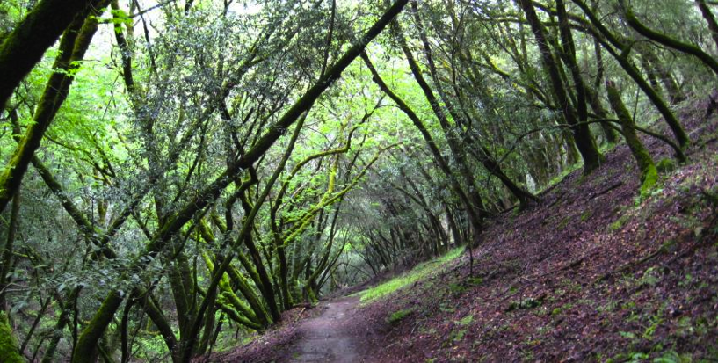
Questions…?

Slide 20
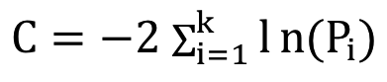
Assessing Model Fit – C-statistic
Notes:
Combine the k probabilities into the C-statistic:
C=-2i=1k ln(Pi)
Compare this C-statistic to a χ2 distribution with 2k degrees of freedom (12 in this case). If the model fit according to this test is sufficient (i.e. p > 0.05), then the coefficients from the multiple regression models may be applied to the appropriate paths.
1. The strength of a compound path is the product of coefficients along that path.
2. The total effect one variable has on another equals the sum of its direct and indirect effects through directed (causal) pathways
d-sep test can not be applied to models that include latent variables (no probability estimate for unmeasured variables)

Slide 21
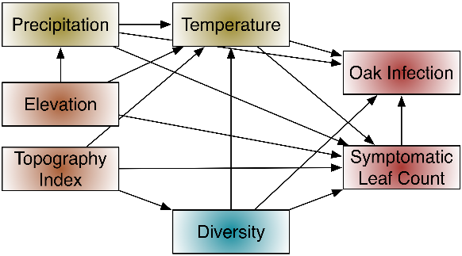
Assessing Model Fit – d-sep test
Independence Set
Variable 1 | Variable 2
Elevation | Topography index
Elevation | Oak infection
Topography | Precipitation
Topography | Oak infection
Diversity | Precipitation
Diversity | Elevation
Notes:
The probable fit of the path model can be assessed by testing the independence claims based on the topology of the graph using the d-sep test (directional separation). Any variables in a DAG that do not have an arrow directly between them are claimed to be independent. The d-sep test gives the necessary and sufficient conditions for two vertices in a DAG to be probabilistically independent conditioning on other vertices. It also depends on the Markov condition where changes at t+1 depend at most on the state at time t so that the more distant past only affects the immediate future indirectly through the present.

Slide 22
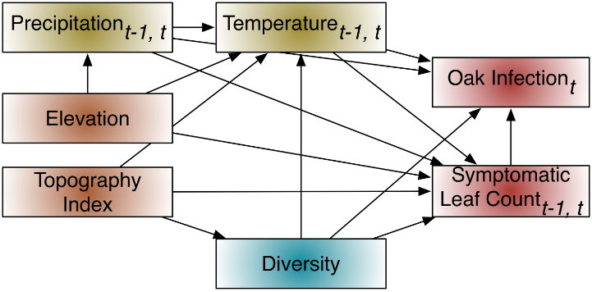
Lag Path Model – Spillover
Notes:
However, the processes of biology and ecology are not static, so past conditions can and do influence present and future conditions in a “lag effect.” A path model explicitly incorporating time through “lag effects” of disease and weather conditions.

